Slide 1
RuleML’ 14
Using Rules to Develop a Personalized
and Social Location Information System
for the Semantic Web
Iosif Viktoratos¹, Athanasios Tsadiras¹, Nick Bassiliades²,
¹Department of Economics, ²Department of Informatics,
Aristotle University of Thessaloniki
GR-54124 Thessaloniki, Greece
{viktorat, tsadiras, nbassili}@auth.gr

Slide 2
Contents
Location Based Social Networking Services (LBSNSs) & Context
Semantic Technologies
The System Geosocial SPLIS
Design and General idea
Geosocial SPLIS’s Features
Geosocial SPLIS’s Architecture
Geosocial SPLIS’s processes
Usage Scenarios
Evaluation
Conclusions
Future work

Slide 3
Location Based Social Networking Services (LBSNSs)
One of the most important sectors of LBS
Used daily by millions of people
Provide users with the capability to locate each other and interact with one another depending on their physical distance
Facebook Places, Foursquare…

Slide 4
LBSNSs & Context
Should offer information to users, relevant to their situation - context
Time, Location, User Preferences, Relationships…
Context awareness enables proactive personalized information of higher quality
Researchers and industries focus on contextual knowledge
Hardware (e.g. GPS, sensors)
Software (e.g. ontologies,rules)

Slide 5
Semantic Technologies Ontologies & Rules
Ontologies
Represent physical entities and their associations
Formal representation standard
Reusability
Interoperability
Flexibility
Knowledge sharing
Rules
Extensive reasoning capabilities
Autonomy – Proactiveness
Intelligence

Slide 6
GeoSocial SPLIS Geosocial Semantic Personalized Location Information System
What?
A personalized LBSNS which connects user defined preferences (regarding POIs) with those of their nearby friends and POI owners’ group targeted offers
Why?
To provide proactive, customized and contextualized information
How?
Combining semantics with LBSNSs

Slide 7
Design and General idea
Human mobility behavior is not completely random
Regular users have preferences/daily patterns
If it is Saturday noon I would like some restaurants that serve Italian cuisine
POIs adopt a rule-based policy to deploy their specific marketing strategy
A museum offers 15% discount to students on Fridays
The service collects user’s context
Combines all the above and presents personalized offers on Google Maps
7/40

Slide 8
Geosocial SPLIS’s Features (1/2)
Collects data from external sources
Google+, Google Places API, POI websites
Regular users add contextualized rule based preferences via a web editor
POI owners add group targeted offering policies via a web editor
Data from editor → RuleML → Jess →Sesame
Executes and evaluates data and rules on the fly
Uses Google Maps for visualization

Slide 9
Geosocial SPLIS’s Features (2/2)
Rule conditions
LBS context
Location (e.g. within 800m)
Weather (e.g. sunny, rainy etc. )
Time (e.g. between 13:00-17:00)
Day (e.g. Monday)
Every existing property of a POI
E.g. cuisine currently serves
Rule consequences
Add a place in a recommendation list

Slide 10
Geosocial SPLIS’s Architecture (1/2)
Client
PC browser-based
Html, JavaScript, Css
Google Maps
Server
Java Server Pages (JSP)
RDF data management
Sesame
Rules
Reaction RuleML → XSLT → Jess

Slide 11
Geosocial SPLIS’s Architecture (2/2)

Slide 12
Geosocial SPLIS’s processes(1/10)
Presentation of Information process
Data collection
Data retrieval
Rule evaluation
Presentation of personalized information
Processes concerning rules
Rule insertion through editor
Rule modification process
“Get a rule process”
Processes exploiting social ties
Common social interaction processes (e.g. friendships)
Nearby friends’ mode
12/40

Slide 13
Geosocial SPLIS’s processes(2/10) Presentation of Information process
Data collection process
Load the schema.org ontology
Get user data either from a registration form or from Google+ account
Retrieve POIs from Google Places API
Store data for POIs into Sesame
Data retrieval
Fetch user’s profile data and rules (if any)
Calculate contextual property values
Fetch POIs’ property values and rules (if any)

Slide 14
Geosocial SPLIS’s processes(3/10) Presentation of Information process
Rule evaluation
Assert data and rules to Jess
Evaluate rules using the asserted facts
Send evaluated data to server
Presentation of personalized information
Bigger in size marker → recommended POI
Green marker → at least one valid offer for the user
Yellow marker → no rule is fired for the current user
Red marker → no offers at all
Red star → POI owner

Slide 15
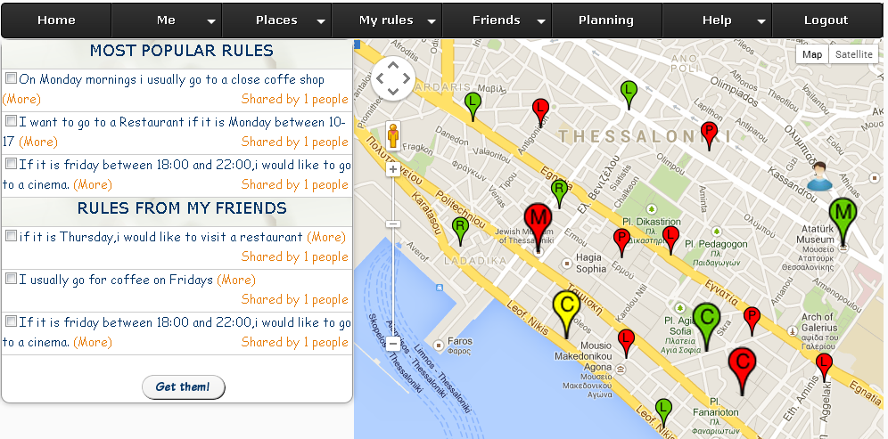
Geosocial SPLIS’s processes(4/10) Presentation of Information process
PC browser-based version

Slide 16
Geosocial SPLIS’s processes(5/10) Rule insertion through editor
Rule title and the priority fields
Four “Add …. Condition” buttons
Each one for the corresponding contextual condition
The condition customization consists of three elements:
The property field (weather, day, time, distance)
The operator field (“is” and “<”,”>” for time and distance)
The value
An “AND” is implied among them
Select POI category
“Add Where Condition” button to add more conditions regarding POI properties
Add a textual explanation
Assert the rule “If day is Sunday and weather is Sunny, then I would like an IceCreamShop”

Slide 17
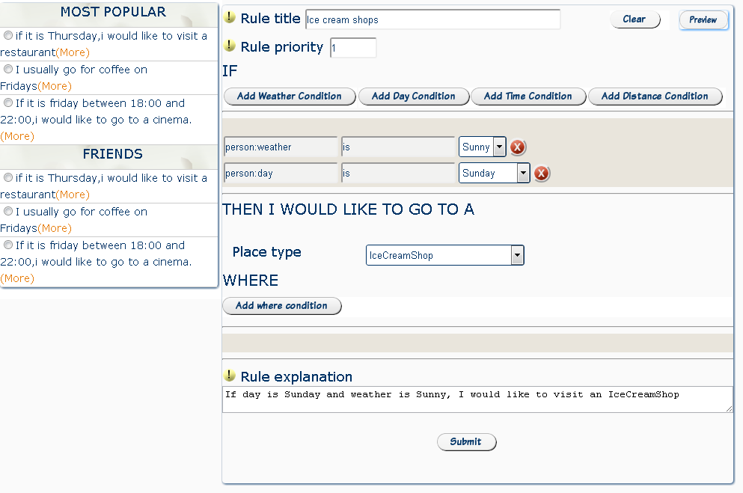
Geosocial SPLIS’s processes(6/10) Geosocial SPLIS’s Web Editor

Slide 18
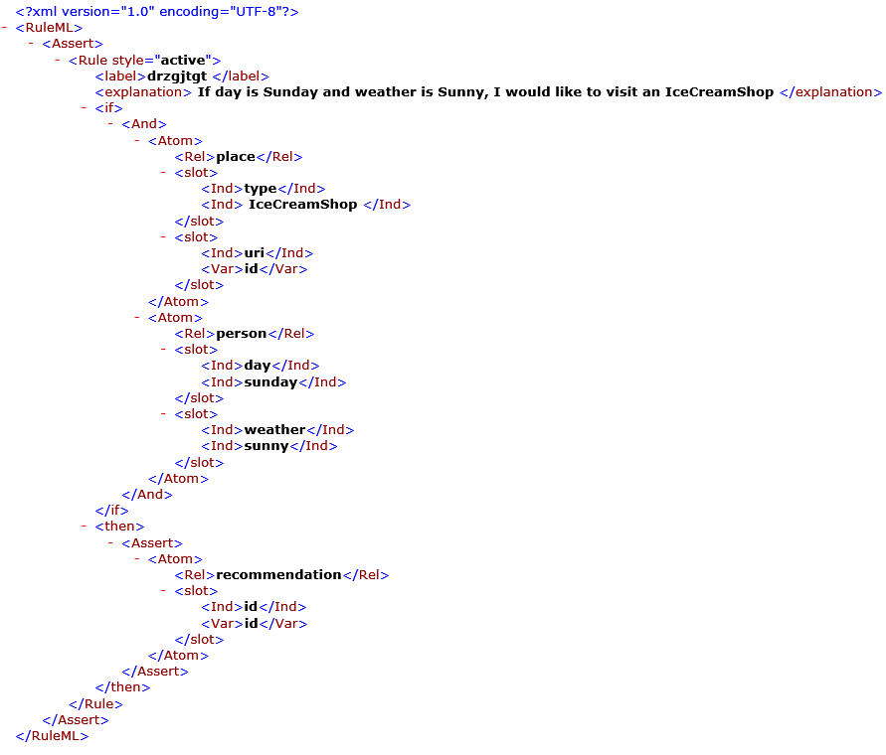
RuleML representation
Jess representation
(defrule kctysfvn (declare (salience 1))
(place( type IceCreamShop) ( uri ?id))
(person ( weather sunny) ( day sunday))
=>
(assert (recommendation( id ?id)))
(store EXPLANATION "If day is Sunday and weather is Sunny, I would like to visit an IceCreamShop"))
18/40

Slide 19
Geosocial SPLIS’s processes(8/10) Rdf data representation
Geosocial SPLIS: policy19d883ef-f735-4521-a8a6 771065b1b2a8 | rdf:type | Schema:Policy;
 | schema: policy_description | IF person:weather is Sunny AND person:day is Sunday THEN I WOULD LIKE TO GO TO A place:type IceCreamShop
 | schema: policy_explanation | If day is Sunday and weather is Sunny, I would like to visit an IceCreamShop
 | schema: policy_priority | 1
 | schema: policy_link | platon.econ.auth.gr/......ruleml
schema: Person22 | schema:Policy | Geosocial SPLIS: policy19d883ef-f735-4521-a8a6 771065b1b2a8

Slide 20
Geosocial SPLIS’s processes(9/10) Processes concerning rules
Rule modification process
Edit and delete a rule through editor
“Get a rule” process
Get rules from other users
Check and get the rule
In case of editing a rule, a user is simply “unlinked” from the rule so that not to affect other users
20/40

Slide 21
Geosocial SPLIS’s processes(10/10) Processes exploiting social ties
Common social interaction processes
Messages, Friendships’ creations, View profiles…
Nearby friends’ mode
Collects user’s and his/her nearby (logged in) friends’ rules and context
Evaluates rules and fetches recommended nearby POIs
Gets POIs’ rules and evaluates them concerning all users’ contexts
Provides group-based information
21/40

Slide 22
Usage Scenarios(1/10) Normal usage
A scenario concerning two different users
Name | Age | JobTitle | Time | Day | Weather | Location
John | 20 | Student | 13:45 | Saturday | Sunny | Location A
Name | Age | JobTitle | Time | Day | Weather | Location
Mary | 21 | Student | 13:45 | Saturday | Sunny | Location B
22/40

Slide 23
Usage Scenarios(2/10) Normal usage
Possess the following rules
John’s rules |  | Mary’s rules
Rule 1 | “If it is Saturday between 13:00 and 16:00, I would like to go for coffee ” | “I would like to go for coffee, if weather is Sunny and time is before 18:00 o’clock”
Rule 2 | “If it is Wednesday and time is after 18:00, find me cinemas which are closer than 1000 m” | “If it is Friday between 19:00 and 22:00, find me some Restaurants which serve Italian cuisine”
Rule 3 | “On Saturday afternoons (12:00-15:00), recommend me a Museum” | _

Slide 24
Usage Scenarios(3/10) Normal usage-John
Consider John
John’s rules 1 and 3 are fired because it is Saturday and time is 13:45
Coffee shops and museums are represented with a bigger marker
Green markers indicate that there is a valid offer for him
Can get rules from his friends or from other users
24/40

Slide 25
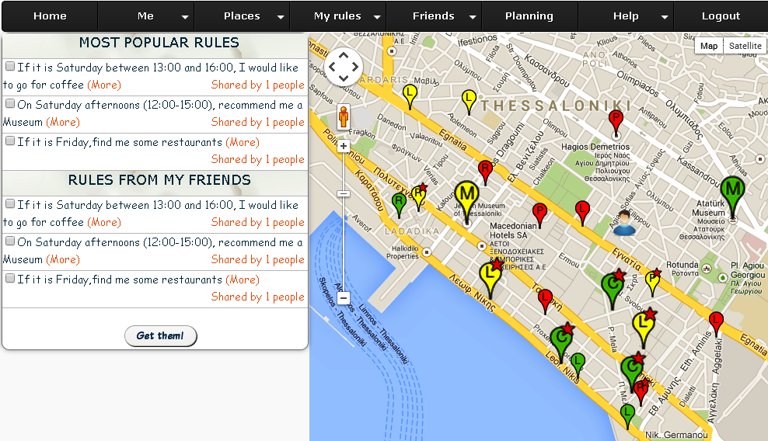
Usage Scenarios(4/10) Normal usage-John

Slide 26
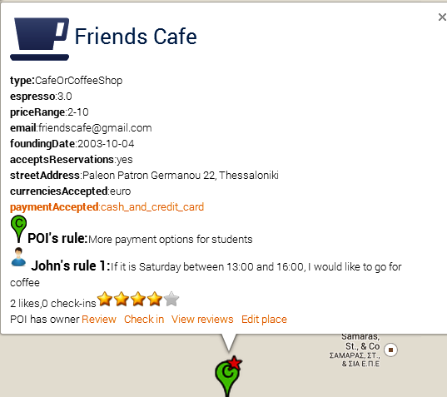
Usage Scenarios(5/10) Normal usage-John
POI “Friends Cafe” is represented with a bigger marker because it is a Coffee shop (rule 1)
John has a valid offer as a student (POI owner’s rule)
26/40

Slide 27
Usage Scenarios (6/10) Friends’ mode-John
Mary is his only nearby friend which is logged in at this time
Gets his and Mary’s context and rules
Evaluates rules and fetches nearby recommened POIs
John’s rule 1 and 3 are fired and as a result museums and coffee shops are recommended
Mary’s rule 2 is fired, which recommends coffee shops.
Gets POIs’ rules and evaluates them based on John and Mary’s contexts
Presents information
27/40

Slide 28
Usage Scenarios (7/10) Friends’ mode-John
Presentation of information
Red marker → POI that does not have any offer at all
Yellow marker → POI that has at least one offer, but it is not valid for none of them
Half yellow-half green → POI has a valid offer for at least one of the friends or the user
Green → POI has an offer for all of them
A bigger marker → POI is recommended by a user rule and at least one of his/her friends’ rules
28/40

Slide 29
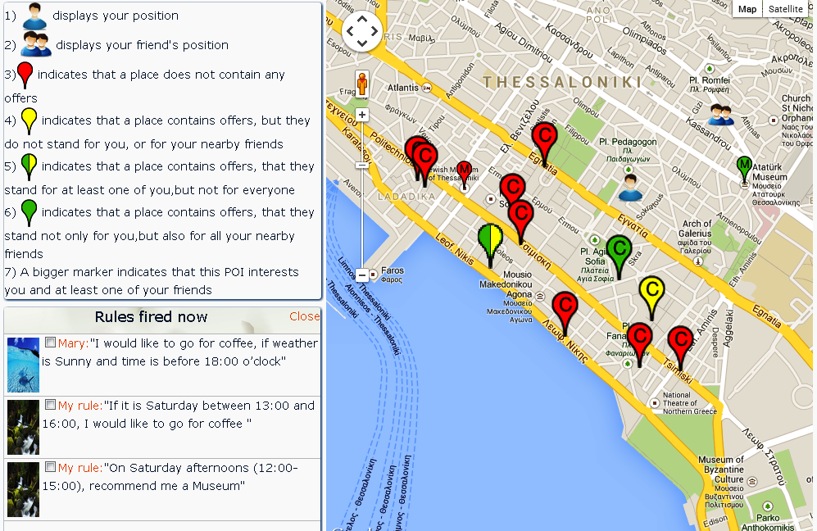
Usage Scenarios (8/10) Friends’ mode-John

Slide 30
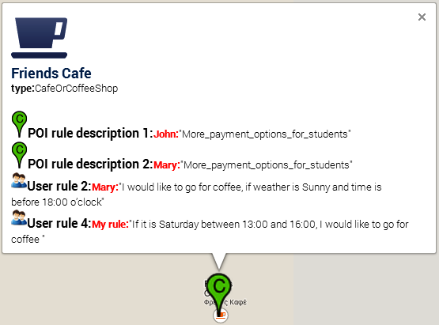
Usage Scenarios (9/10) Friends’ mode-John
30/40

Slide 31
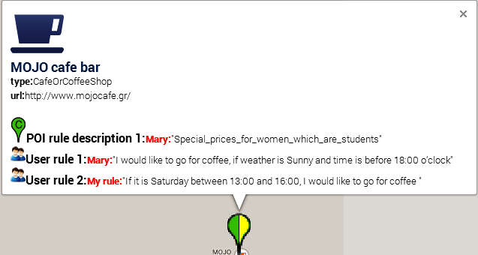
Usage Scenarios (10/10) Friends’ mode-John
31/40

Slide 32
Evaluation(1/6)
83 undergraduate students of Economics (18-22 years old, both genders)
Three parts of questions about:
Processes concerning rules and the personalization of information
Social processes
The system in general
32/40

Slide 33
Evaluation(2/6)
Q1. How easy was to add a rule?
Q2. How easy was to modify a rule?
Q3. Are you satisfied with the provided interface?
Q4. How easy was to find and get a rule from another user?
Q5. How easy was to understand why a place was recommended?
Q6. How easy was to find a place that resulted by your rules and had an offer for you?
33/40

Slide 34
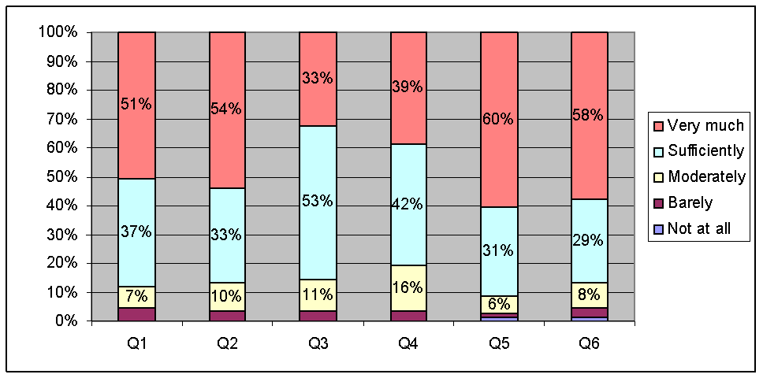
Evaluation(3/6)
For every question, over 80% of the answers were “sufficiently satisfied” or “very much satisfied”
34/40

Slide 35
Evaluation(4/6)
Q7. How easy was to send a friend request?
Q8. How easy was to understand which of your friends recommend a place and why?
Q9. How easy was to find common places for you and your friends?
Q10. How easy was to find places that resulted by your friends’ rules and had an offer for you?
35/40

Slide 36
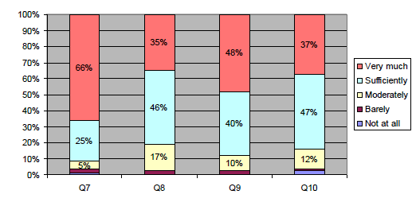
Evaluation(5/6)
For every question, over 80% of the answers were “sufficiently satisfied” or “very much satisfied”
36/40

Slide 37
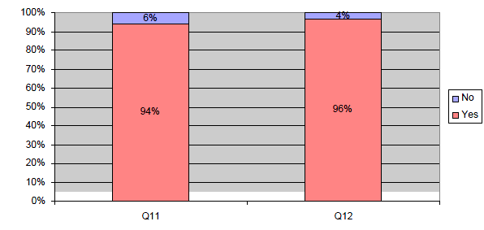
Evaluation(6/6)
Q11.Will you continue using the system?
Q12.Would you recommend the system to your friends?

Slide 38
Conclusions
Geosocial SPLIS models human daily preferences and connects them with POI owners group based offering policies
Advantages
POI owners have highly targeted marketing audience
Regular users enjoy proactive contextualized information
Adding rules dynamically leads to more customized and personalized user experience
The more rules were added to the system, the more interesting/intelligent it becomes
Exploit people collaboration and social intelligence to create large knowledge bases
38/40

Slide 39
Future work
More extensive user evaluation
Expand the editor to add a wider range of preferences (movies, music etc.)
Rules (semi-)automatically induced by mining users’ logs, likes or reviews
Connect other social media sources (facebook, twitter etc.)
39/40

Slide 40
Thanks for your time!
Geosocial SPLIS is available at: http://tinyurl.com/GeoSPLIS
Mobile version is available at: http://tinyurl.com/GeoSoSPLIS
40/40

